Slide 1
Project 1.2
Olivia Justynski, Yuyang Liu, Jiawei Wang

Slide 2
Compare the variants in Carl’s genome with those found in the GTEx database. Use the results to predict gene expression in various tissues and better estimate the impact of noncoding variants in Carl’s genome.

Slide 3
Writing
Describe eQTLs and the GTEx database. How was the data present in GTEx generated and what scientific questions does it help answer?

Slide 4
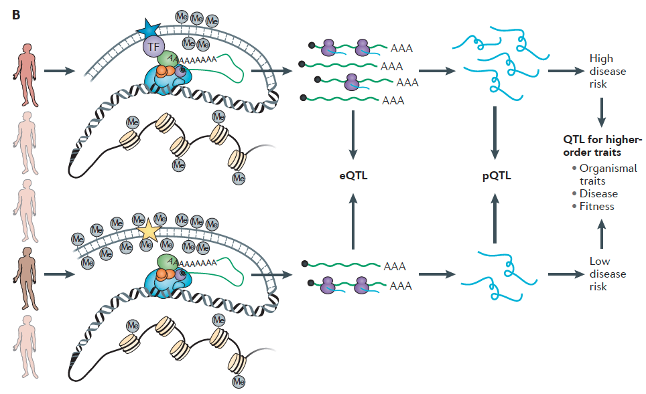

Slide 5
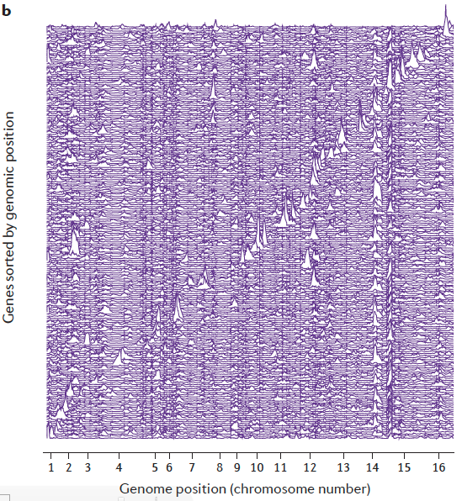

Slide 6
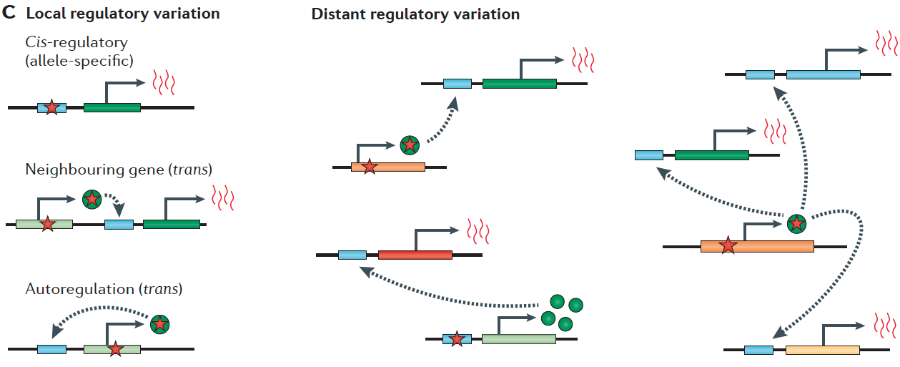

Slide 7
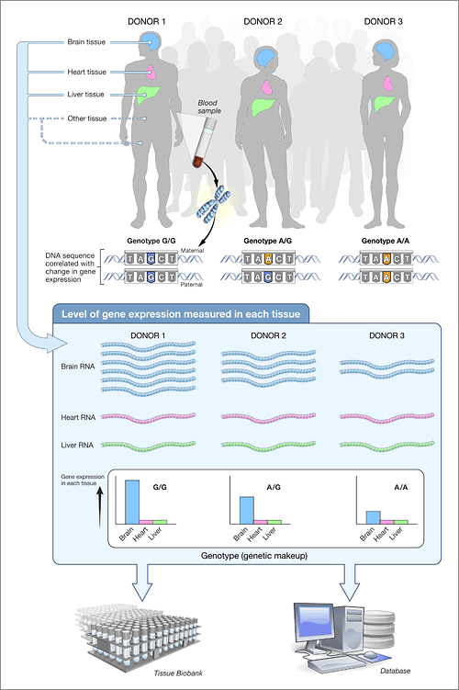

Slide 8
Coding
Propose a tool to identify eQTLs in a subset of Carl’s variants using the GTEx database. What expression changes would you predict in Carl? Make sure to cover tissues that can be easily assayed.

Slide 9
Pipeline
Process the variants in Carl’s genome to identify any eQTLs. Look at multiple tissues (make sure to include tissues that might be able to be tested in a noninvasive manner e.g. blood).

